Slide 2
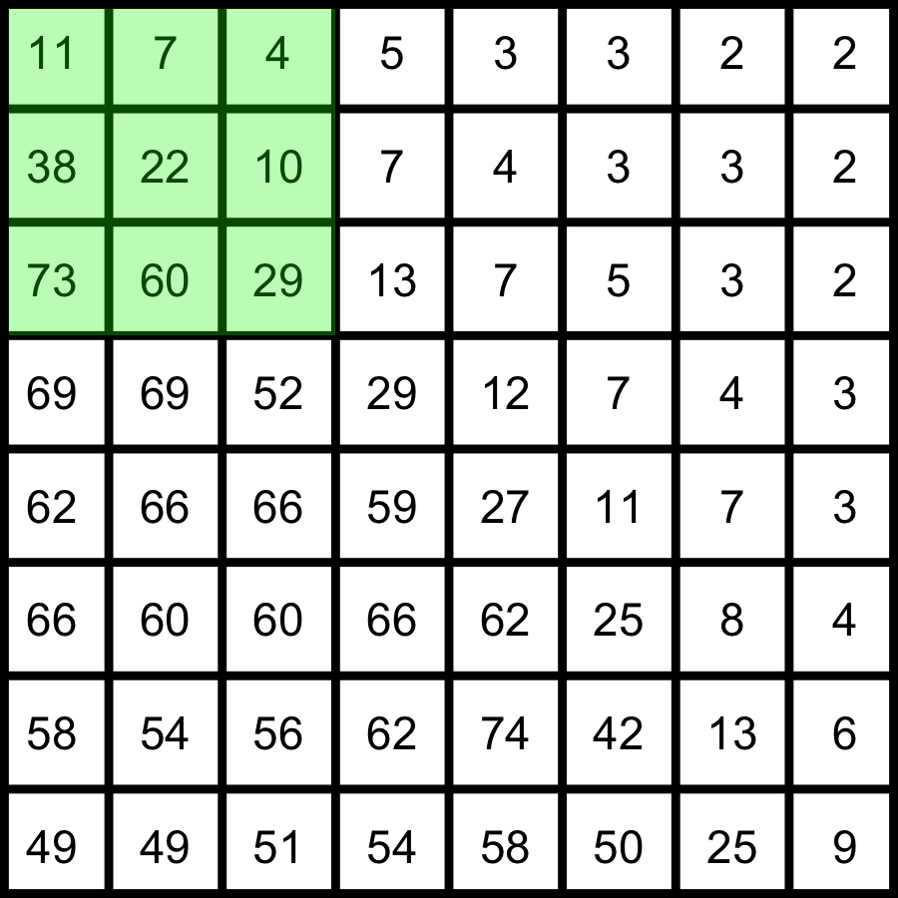
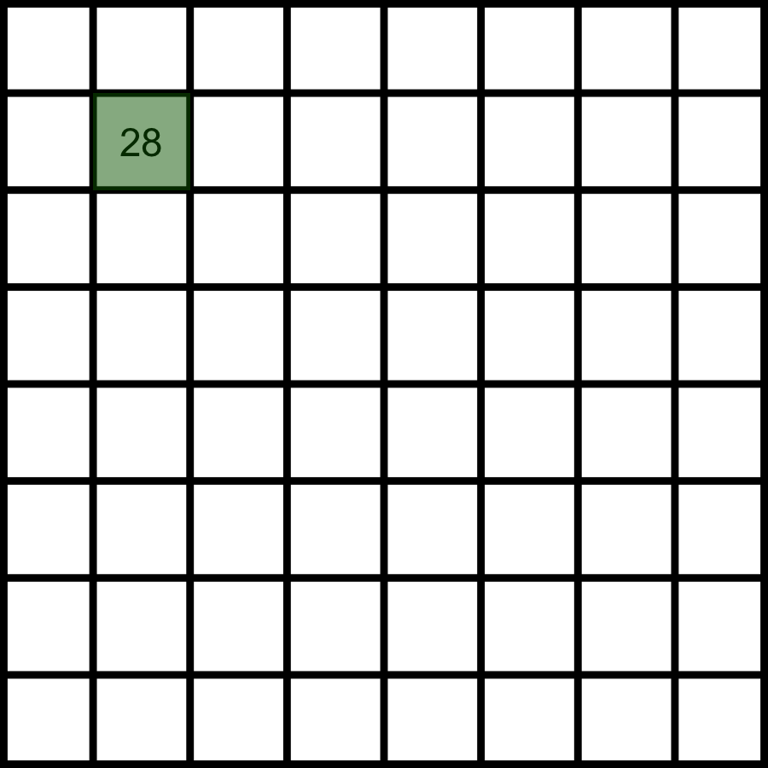
Rank filters (median, min, …)
4
7
10
11
22
29
38
60
73
min
22
median
=
max
Original image
Sort and rank
Median image
Notes:
Draw min, max and median

